Slide 1
Tech-Edge Lab
Topic: -
Generative AI & Intelligent Application Development Bootcamp
Sub-topic:-
Industry-Oriented Training Program on LLMs, AI Tools, AI Agents & Vibe Coding

Slide 2
Instructions to follow carefully:-
Be curious and ready to learn beyond the classroom.
Bring your laptop and ensure a stable internet connection for practice.
Attend every session and participate actively.
Stay focused during class and complete all hands-on activities.
Practice regularly after each session.
Ask questions whenever you have doubts.
Work on mini-projects to strengthen your skills.
Maintain discipline and a positive learning attitude.

Slide 3
Module 1:- AI industry and Careers
Lecture 1:-
Introduction to AI Era
(Course Introduction, Why learn AI, AI Vs Programming, AI Jobs, AI salary, AI roadmap for BCA, What companies expect)

Slide 4
Activity:
Raise Your Hand Survey
Question:
How many students have already used ? :-
ChatGPT
Gemini
GitHub Copilot
Claude
Perplexity
Q- "Who has used AI for completing assignments?"
Q- "Who has used AI for coding?"

Slide 5
Index
S.No. | Topic
1. | Course Introduction
2. | Why this Bootcamp? Learning Outcomes
3. | Welcome to the AI Era
4. | AI is Everywhere
5. | Why Learn AI?
6. | Why AI Matters for BCA Students
7. | AI vs Traditional Programming
8. | Can AI Replace Programmers?
9. | Evolution of software development
10. | Gen AI & Examples
11. | AI Jobs, skills, salary
12. | AI Roadmap for BCA Students
13. | What Companies Expect
14. | Future software Developers
15. | Bootcamp Roadmap

Slide 6
1. Introduction
What is this Bootcamp?
  This bootcamp is designed to prepare students for the rapidly changing software industry where Artificial Intelligence is becoming a core part of software development.
  The program focuses on practical learning rather than theory. Students will learn how to use modern AI tools to increase productivity, automate tasks, and build intelligent applications.

Slide 7
What You Will Learn
Fundamentals of Artificial Intelligence
Generative AI
Large Language Models (LLMs)
AI Chatbots
AI Coding Assistants
Prompt Engineering
AI Agents
Intelligent Web Applications
API Integration
Vibe Coding
AI Project Development
Resume Building using AI
Industry Workflow

Slide 8
2. Why This Bootcamp?
Today's software companies no longer expect developers to write every line of code manually.
  Instead, they expect developers who can:
  Use AI tools efficiently
  Build applications faster
  Automate repetitive tasks
  Improve software quality
  Increase productivity
  Solve real-world problems using AI
This bootcamp bridges the gap between college education and industry expectations.

Slide 9
3. Learning Outcomes
  After completing this bootcamp, students will be able to:-
✓ Understand AI fundamentals
✓ Use ChatGPT effectively
✓ Work with multiple AI tools
✓ Build AI-powered applications
✓ Use LLM APIs
✓ Create AI Agents
✓ Perform Prompt Engineering
✓ Develop projects faster using AI
✓ Prepare for AI-enabled software jobs

Slide 10
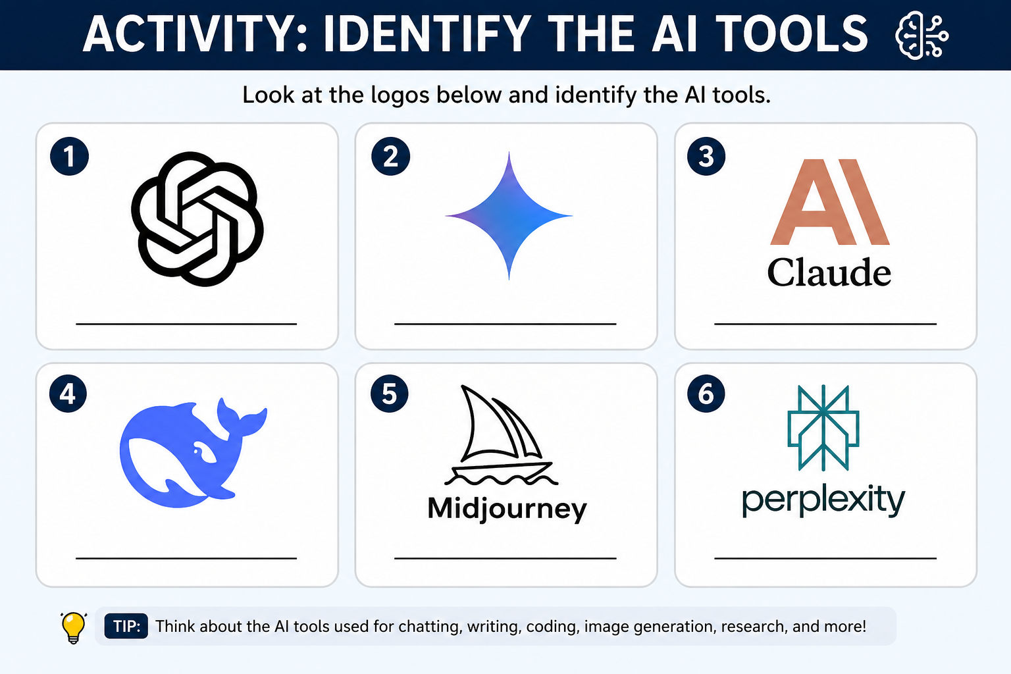

Slide 11
4. Welcome to the AI Era
  The Fourth Industrial Revolution
      Earlier Revolutions
      Steam Engine
      Electricity
      Computers & Internet
      Artificial Intelligence
Today, AI is transforming every industry just like computers transformed businesses in the 1990s.
    Examples
    Healthcare
    Banking
    Education
    Agriculture
    Manufacturing
    Retail
    Government
    Entertainment
    Cyber security

Slide 12
5. AI is Everywhere
Examples of AI You Already Use
  Google Search
  YouTube Recommendations
  Netflix Suggestions
  Instagram Feed
  Amazon Recommendations
  Google Maps
  ChatGPT
  GitHub Copilot
  Google Gemini
  Claude
  Perplexity
AI has become part of our daily life—even when we don't realize it.

Slide 13
Activity: AI Hunt
Q-
Find 10 AI applications you used today before entering class.
Examples
    ?
Give 2 minutes.

Slide 14
6. Why Learn AI?
According to industry reports,
AI is becoming one of the fastest-growing technologies.
Reasons to Learn AI
  High demand in software companies
  Better salary packages
  Faster career growth
  Increased productivity
  Ability to automate work
  Competitive advantage
  Better freelancing opportunities
  Startup opportunities

Slide 15
Activity Ask?
  Why are you learning AI?
  Options
    Placement
    Higher Salary
    Freelancing
    Startup
    Curiosity

Slide 16
Activity:- Think-Pair-Share
Question
  Imagine you get placed in TCS.
Would you rather
A)
Write 1000 lines manually
OR
B)
Use AI to finish in 2 hours

Slide 17
7. Why AI Matters for BCA Students
Traditional Skill
Write code manually
↓
Modern Skill
Use AI + Programming
↓
Future Skill
Build AI-powered products
Companies now expect graduates to know both programming and AI.

Slide 18
8. AI vs. Traditional Programming
Traditional Programming | AI Programming
Human writes logic | AI generates logic
Manual coding | AI-assisted coding
Time consuming | Faster development
Fixed rules | Learns patterns
Programmer solves everything | AI assists developer
Less automation | High automation
Important:
AI does NOT replaces programming.
AI enhances programming.

Slide 19
9. Can AI Replace Programmers?
Common Myth
"AI will replace software engineers."
Reality
AI replaces repetitive tasks—not problem-solving skills.
Companies still need developers who can:
Think logically
Design software
Understand requirements
Debug systems
Communicate with clients
Review AI-generated code
The future belongs to developers who know how to use AI effectively.

Slide 20
Activity :- Mini Challenge
Ask
Can AI solve these without humans?
Decide business requirements?
Understand customer emotions?
Handle office politics?
Design software architecture?
Fix production bugs?
- Yes/No.

Slide 21
10. AI + Programmer = AI Enabled Programmers
Without AI
    Idea
    ↓
    Coding
    ↓
    Debugging
    ↓
    Documentation

Slide 22
With AI
  Idea
  ↓
  AI Assistance
  ↓
  Coding
  ↓a
  Testing
  ↓
  Deployment
Result
    Faster Development
    Better Productivity
    Higher Quality

Slide 23
Demonstration
A student
"Write code to reverse a string."
B student
Use ChatGPT.
Compare
  Time
  Accuracy
  Readability

Slide 24
11. Evolution of Software Development
Past
Write every line manually.
Present
AI suggests code.
Future
  Describe your idea.
  ↓
  AI generates the application.
  ↓
  Developer verifies and improves it.
This is called AI-assisted software development.

Slide 25
11. What is Generative AI?
Generative AI is a type of Artificial Intelligence that creates new content instead of only analyzing existing data.
It can generate
  Text
  Images
  Videos
  Audio
  Code
  Documents
  Presentations
  Websites
Examples
  ChatGPT
  Gemini
  Claude
  Midjourney
  GitHub Copilot

Slide 26
Activity:- Live Demo
Open ChatGPT.
Ask students
Give me one random prompt.
Examples
    Write a leave application
    Create logo
    Python program
    Explain DBMS
Generate instantly.
Huge engagement.

Slide 27
12. AI Jobs in 2026
  Popular Roles
    AI Engineer
    Prompt Engineer
    Machine Learning Engineer
    Data Scientist
    AI Application Developer
    Full Stack AI Developer
    LLM Engineer
    AI Automation Engineer
    AI Product Manager
    AI Research Engineer
    AI Consultant

Slide 28
13. AI Skills Required by Companies
Problem Solving
Programming
  Python
  JavaScript
  Java
AI Skills
  Prompt Engineering
  LLMs
  AI APIs
  Automation
Tools
  Git
  GitHub
  VS Code
Cloud
Communication
Projects , Portfolio

Slide 29
14. AI Salary (India)
Approximate Annual Salary
  Freshers
    ₹3 –10 LPA
  1–3 Years
    ₹10–20 LPA
  Senior AI Engineer
    ₹20–40+ LPA
  Top Product Companies
    ₹40 LPA to ₹1 Crore+ (Total Compensation)
Note: Salaries vary based on skills, company, location, and experience.

Slide 30
15. AI Roadmap for BCA Students
Step 1
Programming Fundamentals
↓
Step 2
Python
↓
Step 3
Data Structures
↓
Step 4
Web Development (SDLC)
↓

Slide 31
Step 5
Git & GitHub
↓
Step 6
Generative AI
↓
Step 7
LLMs
↓
Step 8
Prompt Engineering
↓
Step 9
AI APIs
↓
Step 10
AI Agents

Slide 32
Step 11
Projects
↓
Step 12
Internship & Placement

Slide 33
16. What Companies Expect
i) Technical Skills
  Programming
  Database
  APIs
  Git
  AI Tools
  Cloud Basics
ii) Professional Skills
  Communication
  Teamwork
  Critical Thinking
  Problem Solving
  Adaptability
  Continuous Learning
iii) AI Skills
  ChatGPT , Prompt Engineering
  AI Productivity, LLM Integration, AI Automation

Slide 34
17. Future Software Developer
Traditional Developer
Writes Code
↓
Modern Developer
Writes Code + Uses AI
↓
Future Developer
  Builds Intelligent Applications
  Creates AI Agents
  Automates Business Processes

Slide 35
18. Bootcamp Roadmap
Module 1
  Intro to AI Era
Module 2
  Prompt Engineering
Module 3
  AI Tools
Module 4
  Large Language Models
Module 5
  OpenAI APIs
Module 6
  Building AI Applications
Module 7
  AI Agents
Module 8:- Vibe Coding
Module 9:- Project Development
Module 10:- Resume + Interview Preparation

Slide 36
19. Key Takeaways
AI is transforming every industry.
AI is a powerful assistant, not a replacement for skilled developers.
Generative AI creates text, code, images, audio, and more.
BCA students should combine programming skills with AI knowledge.
Companies increasingly expect graduates to know AI tools, LLMs, and prompt engineering.
Continuous learning and hands-on projects are essential for success in the AI era.

Slide 37
Thank You
Questions & Discussion

